Slide 1
Building the Use-Case Model
(Fall 2019)
Software Requirements Analysis
Week 5
Software Requirements Analysis

Slide 2
Agenda
Review of the previous lecture
Step-By-Step Building of the Use-Case Model
Hierarchy of Use Cases levels
Relationships between use cases
Templates for use cases
Exercise
Key Points
Next?
Software Requirements Analysis

Slide 3
Review: Elicitation techniques
Specific techniques which may be used to collect knowledge about system requirements
    Interviews and questionnaires
    Requirements workshop
    Brainstorming sessions and idea reduction
    Storyboards
Software Requirements Analysis

Slide 4
Context of the System
System Context - summarizes the high-level behavior of a system
  What the system does (as a black-box)
  What lies outside of the system
  How it gets used
Use-Case Model: requirements in context
Software Requirements Analysis

Slide 5
A Step-By-Step Building of the Use-Case Model
Step 1: Identify and describe the Actors
Step 2: Identify the use Cases and write a Brief Description
Step 3: Identify the Actor and use-Case Relationships
Step 4: Outline the Individual Use Cases
Step 5: Refine the Use Cases
Software Requirements Analysis

Slide 6
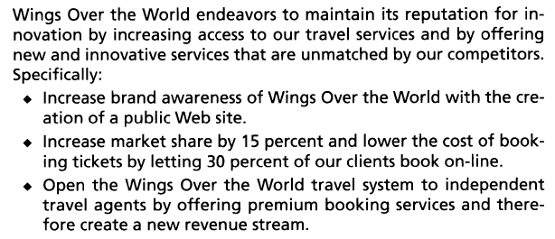
Small Example: Wings Over the World Company
Vision (Objectives and goals):
Software Requirements Analysis

Slide 7
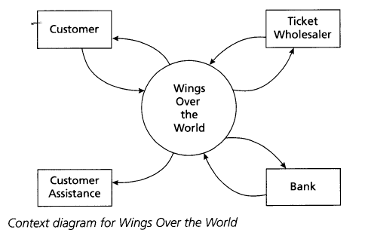
Wings Over the World Company: Context
Context diagram: an excellent starting point for building the use case set (not part of UML)
    Discuss agent as an actor within the system
Software Requirements Analysis

Slide 8
Step 1: Identify and describe the Actors
Actor:
  a role that people or devices play as system operates.
  External to the system itself.
Primary Actor:
  interact to achieve required system function and derive the intended benefit from the system
  Works directly and frequently with the system
Secondary Actor:
  Supports the system so that primary actors can do their work
Software Requirements Analysis

Slide 9
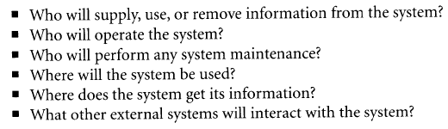
Step 1 (cont.)
How to identify the actors?
  The following questions might be helpful:
Software Requirements Analysis

Slide 10
The basic model of use cases is that
Actors interact to achieve their goals
Primary Actor
person or system with goal for s.u.d.
System under development (s.u.d)
could be any system
Secondary Actor
other system against
which s.u.d. has a goal
Responsibility
- Goal 1
- Goal 2
... action 1
.
:
- backup goal
for Goal 2
(Interaction 1)
Responsibility
- Goal 1
...action 1
(Interaction 2)
Responsibility
Software Requirements Analysis

Slide 11
A Step-By-Step to Building the Use-Case Model
Step 1: Identify and describe the Actors
Step 2: Identify the Use Cases and write a Brief Description
Step 3: Identify the Actor and use-Case Relationships
Step 4: Outline the Individual Use Cases
Step 5: Refine the Use Cases
Software Requirements Analysis

Slide 12
Step2: Identify Use Cases
What does each actor need our system to do?
  Each need shows up as a trigger to our system.
Result: a list of use cases, a sketch of the system.
  Short, fairly complete list of usable system function.
Software Requirements Analysis

Slide 13
Examing the Goals the system supports makes good functional requirements.
“Place an order.”
“Get money from my bank account.”
“Get a quote.”
“Find the most attractive alternative.”
“Set up an advertising program.”
Goals summarize system function in understandable, verifiable terms of use.
Software Requirements Analysis

Slide 14
Users, executives and developers appreciate seeing requirements in the form of goals.
Users:
“We can understand what these mean”
“You mean we are going to have to ...?”
Executives:
“You left out one thing here ...”
Developers:
“These are not just a pile of paragraphs!”
Software Requirements Analysis

Slide 15
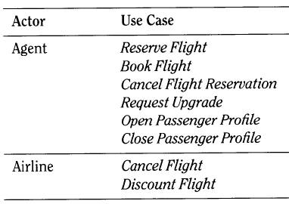
Example: Wings Over the World Company
Sample Actor and Goals
Software Requirements Analysis

Slide 16
Step 2: … and write a Brief Description
Simple, one-paragraph stories describing the main success scenario for the use case
Role: to define a broad scope of the system
Wings over the World:
Software Requirements Analysis

Slide 17
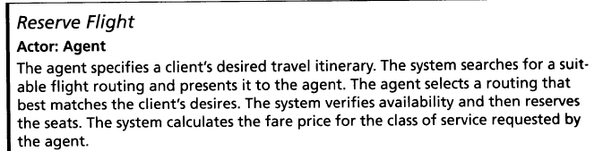
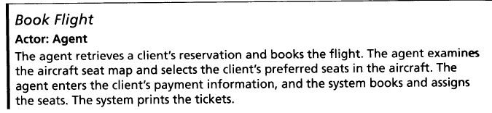
Example of Brief Descriptions of
Use Cases
Software Requirements Analysis

Slide 18
A Step-By-Step to Building the Use-Case Model
Step 1: Identify and describe the Actors
Step 2: Identify the Use Cases and write a Brief Description
Step 3: Identify the Actor and use-Case Relationships
Step 4: Outline the Individual Use Cases
Step 5: Refine the Use Cases
Software Requirements Analysis

Slide 19
Actor-Goal List – original
Actor | Goal (Use Case)
User | Login
 | Submit report
Administrator | Login
 | Submit report
 | Add Users
 | …
Software Requirements Analysis
Notes:
Only primary actors are noted.

Slide 20
Actor-Goal List – refined
User-goal level
Actor | Goal (Use Case)
User | Login
 | Submit report
Administrator | Login
 | Submit report
 | Add Manage Users
 | …
Software Requirements Analysis
Notes:
Only primary actors are noted.

Slide 21
A Step-By-Step to Building the Use-Case Model
Step 1: Identify and describe the Actors
Step 2: Identify the Use Cases and write a Brief Description
Step 3: Identify the Actor and use-Case Relationships
Step 4: Outline the Individual Use Cases
Step 5: Refine the Use Cases
Software Requirements Analysis

Slide 22
Step 4: Outline the Individual (User-Goal Level) Use Cases
Expand a subset of Briefs and begin to fill in their details (a.k.a. Surface and Dive technique)
Satisfies a particular and immediate goal of value to the primary actor.
Includes Step-by-step descriptions of the main success scenario
Wings Over the World:
Software Requirements Analysis
Notes:
The main success scenario, the happy day case.
Easiest to read and understand.
Everything else is a complication on this.
Capture each actor’s intent and responsibility, from trigger to goal delivery.
Say what information passes between them.
Number each line.
Result: readable description of system’s function.

Slide 23
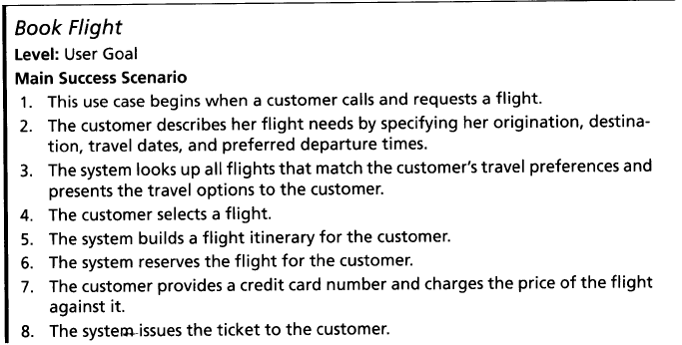
Example of User Goal Level Use Case
Software Requirements Analysis

Slide 24
Exercise: Dice Game
Use Case Model:
Actor’s goal is to
Dice Game Brief Description:
A player rolls two dice.
If the total is seven, the player wins; otherwise he loses.
Play DiceGame
Actor is the Player
Software Requirements Analysis

Slide 25
Play DiceGame: Main Scenario
Player indicates to the system that s/he wishes to start a new game. [Trigger]
System indicates that the player can take a turn.
Player indicates that s/he wishes to take a turn.
System simulates rolling a die and displays the face value.
Steps 3 and 4 are repeated once.
System calculated the total and displays congratulations message.
Alternatives?
Software Requirements Analysis

Slide 26
Write failure conditions as Extensions.
Usually, each step can fail.
Note the failure condition separately, after the main success scenario.
Result: list of alternate scenarios.
Software Requirements Analysis

Slide 27
The use case pulls goal & scenarios together, Each scenario says how 1 condition unfolds.
The use case name is the goal statement:
“ Order product from catalog”
Scenario (1): Everything works out well ...
Scenario (2): Insufficient credit ...
Scenario (3): Product out of stock ...
(Note the grammar: active verb first)
Software Requirements Analysis
Notes:
Why was this important?
It clarified our vocabulary and
It included all the parts we needed to function
Discuss other ways to write use cases
narrative
formal scripts

Slide 28
A use case tells a story of reaching a goal, or a set of stories of both getting and failing (from A. Cockburn)
UC 4: “Place an order”
“ 1. The clerk identifies the customer, each item and quantity.
2. The System accepts and queues the order.”
Extensions:
“1a. Low credit: Clerk takes prepayment”
“2a. Low on stock: Customer accepts reduced...”
Software Requirements Analysis

Slide 29
Extensions: How to do it? Follow the failure till it ends or rejoins.
Recoverable extensions rejoin main course.
Non-recoverable extensions fail directly.
Each scenario goes from trigger to completion.
  “Extensions” are merely a writing shorthand.
  Can write “if” statements.
  Can write each scenario from beginning to end.
Result: Complete use case
Software Requirements Analysis

Slide 30
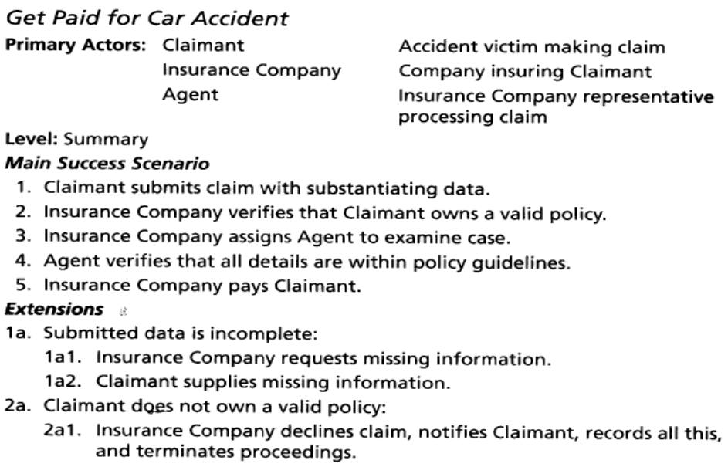
Get Paid for Car Accident Example (from Cockburn 2001)
Software Requirements Analysis

Slide 31
Summary
An actor has goals; goals name use cases; a use case has scenarios naming sub-use cases.
Actor
has
names
Goal
Use case
contains
calls
condition
Scenario
succeed / fail
Software Requirements Analysis
Notes:
Some people feel comfortable seeing ER diagrams of a topic...
There is, of course, more to the model, but this suffices for the talk.

Slide 32
A Step-By-Step to Building the Use-Case Model
Step 1: Identify and describe the Actors
Step 2: Identify the Use Cases and write a Brief Description
Step 3: Identify the Actor and use-Case Relationships
Step 4: Outline the Individual Use Cases
Step 5: Refine the Use Cases
Software Requirements Analysis

Slide 33
Step 5: Refine the Use Cases
Updated use case definition:
  a cohesive set of scenarios tied together by a common user goal.
Pre and Post conditions
Software Requirements Analysis
Notes:
This organization allows readers to focus on the system at varying levels of detail, depending on their need (contains complexity)

Slide 34

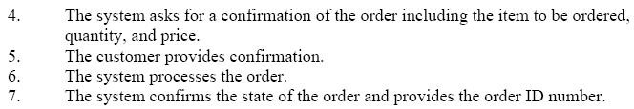
Create an Order Main Scenario
Software Requirements Analysis

Slide 35
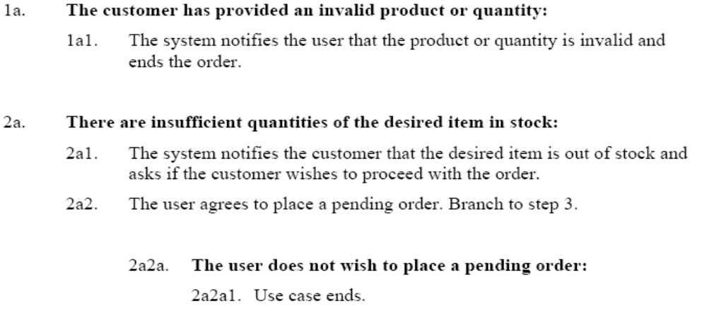
Create an Order: Some Alternative Scenarios
Software Requirements Analysis

Slide 36
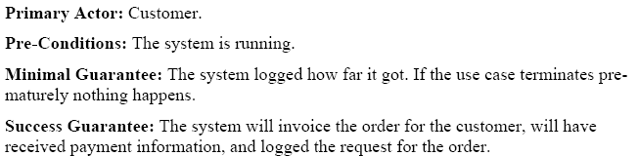
Use Case: Pre- and Post-Conditions (Create an Order)
Software Requirements Analysis

Slide 37
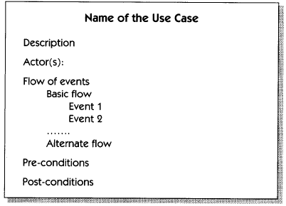
Possible Template for Use Case
Software Requirements Analysis

Slide 38
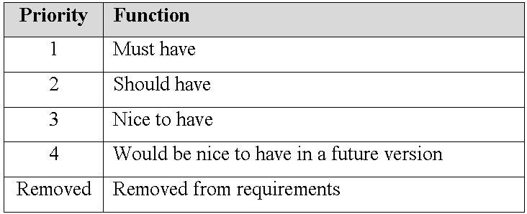
Use Case: Priority
Software Requirements Analysis

Slide 39
More on Scenarios
Some Rules
  Each scenario begins with a triggering action that the system is able to detect
    ATM Withdraw Cash Main Success Scenario
      Customer inserts the card.
      …
  Steps should not be too small
    Stepping up to the sidewalk Main Success scenario
      She lifts her foot from the street to the curb.
      She arcs the foot through the air, and lowers to the pavement
      …
  Keep scenarios to three to nine steps, all at a level of abstraction just below the use case goal
Software Requirements Analysis
Notes:
The step’s goal becomes the complete single goal for a lower level use case. Examples: p.154, “Patterns …”

Slide 40
Structured narrative keeps the context visible, the value to the user clear.
Compare just paragraphs:
“The order entry system has an interface to system EBMS and to a terminal.
It computes and displays the sum of the order items’ cost.
...”
With structured narrative:
“The orderer (EBMS or an entry person) identifies the name of the customer & the items on the order.
The system displays the cost of the total order.
If the items are in stock and the client has sufficient credit, ...”
When? How?
Software Requirements Analysis

Slide 41
Use Case v.s. NFRs, Constraints, Business Rules, etc.
Add Special Requirements section after the list of Extensions
List the non-functional requirements, design constraints and business rules in the Special Requirements section
Software Requirements Analysis

Slide 42
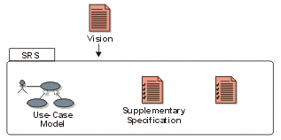
Main Requirements Artifacts
Glossary
Software Requirements Analysis

Slide 43
Requirements Artifacts
Vision Document defines high-level business requirements, user needs and features.
Software Requirements Specification
  Capture all S/W system requirements, either explicitly or by reference.
  Use-case model.
  Supplementary Specifications, Glossary, …
Software Requirements Analysis
Notes:
The Modern SRS is actually part of the “Supplementary Specifications” in the traditional Rational UP. I have identified it separately since it is key.

Slide 44
Key Points
1. Use cases hold functional requirements in an easy-to-read, easy-to-track, text format.
2. A use case collects how a goal succeeds / fails; a scenario shows one specific condition; scenarios & use cases nest.
3. Use cases show only the Functional req’ts.
4. They make a framework for non-functional requirements & project details.
Software Requirements Analysis

Slide 45
The IT industry now loves use cases, but... how do you write large volumes of them? (from A. Cockburn)
Common agreement that use cases are useful.
  Adopted by every OO methodology
  Repeated commendation from developers, users
But what are they really?
How do you structure 180 of them?
  what is their format? level of detail?
Jacobson invented “uses” and “extends” relations:
  when do you use each, how do you type it in?
Software Requirements Analysis

Slide 46
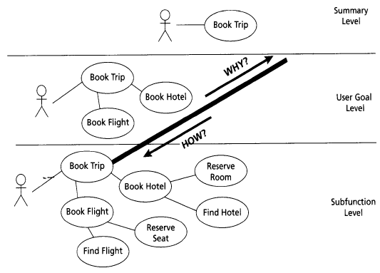
Hierarchy of Use Cases Levels (Cockburn 2001)
Software Requirements Analysis

Slide 47
Exercise
Review use case model for your project
Discuss and write use cases for your current project using the following template:
Software Requirements Analysis

Slide 48
Next: More on Use Cases
Relationships between use cases
Pre- and postconditions for use cases
Use Case v.s. NFRs, Constraints, Business Rules, etc.
Templates for use cases
Software Requirements Analysis

